Slide 1

DETECTION OF WELD FLAW CHARACTERISTICS FROM ULTRASONIC SIGNALS USING CNN
LAKSHMI VAISHNAVI P (40130123)
RAJITHA K (40130092)
Dr.N.M.Nandhitha
Prof. & Dean/SoEE

Slide 2
INTRODUCTION
Ultrasonic testing is pivotal in non-destructive testing of welded structures, offering real-time insights into internal flaws, thereby ensuring structural integrity.
Accurate identification of weld flaws is essential for preventing failures, reducing maintenance costs, and prolonging the lifespan of critical components.
Manual interpretation of ultrasonic signals is time-consuming and error-prone, prompting the exploration of CNNs to automate and enhance flaw detection in welds.
This research aims to apply CNNs for analyzing ultrasonic signals from welded joints, creating an automated system for precise flaw detection, and advancing non-destructive testing methodologies.

Slide 3
PROBLEM STATEMENT
Proposed work involves automating ultrasonic weld flaw detection using Convolutional Neural Networks (CNNs) to overcome manual inspection inefficiencies, enhancing accuracy in non-destructive testing. Performance is measured in terms of accuracy.

Slide 4
OBJECTIVES
Optimize Model for Generalization
Fine-tune the CNN model to ensure robust performance across diverse datasets and welding conditions, addressing overfitting and adapting to variations in ultrasonic signal characteristics.
Evaluate and Validate Performance
Conduct thorough experiments to assess the CNN model's accuracy in detecting and characterizing weld flaws from ultrasonic signals, using appropriate metrics and diverse datasets for validation.

Slide 5
LITERATURE SURVEY #1
Problem Addressed:
Explored the impact of backscattering noise in ultrasonic testing, emphasizing the need to address this issue to analyze flaw echoes accurately.
Methodology Proposed:
This paper presents a comprehensive overview of signal processing techniques used to improve ultrasonic detection method with and without intelligent classifier.
Conclusion:
This paper explains the review on ultrasonic signal processing techniques used in the pipeline system. At first part, type of defect occur in pipeline was overview. The existing signal processing technique was study for de-noising techniques to enhance the signal-to-noise ratio.

Slide 6
LITERATURE SURVEY #2
Problem Addressed:
The auto-encoder network is a kind of typical feature fusion network. The auto-encoder network obtains the fused features of ultrasonic guided waves through signal encoding and decoding and establishes the mapping relationship between the features and the location of defects.
Methodology Proposed:
This paper proposes a method for ultrasonic guided wave detection of corrosion defects in high voltage cable aluminum sheath based on auto-encoder network.
Conclusion:
The detection of corrosion defects in the high voltage cable aluminum sheath is difficult to achieve, this paper proposes an ultrasonic guided wave defect location detection method based on auto-encoder network.

Slide 7
LITERATURE SURVEY #3
Problem Addressed:
The waveform, amplitude and other characteristics of ultrasonic echo are analyzed to determine whether there are defects in the detected workpiece.
Methodology Proposed:
A scanning method was adopted to collect the weld signal of the experimental sample tube. During the test, the water immersion method was used.
Conclusion:
The ultrasonic detection method is used to analyze the time domain of the echo signal of stainless steel welded pipe weld defects, compare and analyze the amplitude changes of different types of weld defect signals, and realize the detection of weld defects.

Slide 8
LITERATURE SURVEY #4
Problem Addressed:
Ultrasonic-based non-destructive spot weld inspection techniques heavily rely on advanced signal processing algorithms developed for this particular application.
Methodology Proposed:
Extraction and representation of feature characteristics in spot weld inspection can be effectively performed through component separation rather than filtering.
Conclusion:
Approximate solutions cannot be used in this particular application in which accurate location of pulses to determine the correct time of flight in each A-scan signal is required

Slide 9
LITERATURE SURVEY #5
Problem Addressed:
The research work aims at developing suitable denoising techniques for Ultrasonic signals and at developing suitable flaw classification technique
Methodology Proposed:
Two different techniques are performed. Firstly, the signals are decomposed using suitable spectral transforms and the features are fed to classified for automated weld flaw classification. Secondly, the input signals are fed as inputs to Long Short term Memory recurrent network and the flaws are characterized. Performance of both these techniques is measured in terms of sensitivity and accuracy.
Conclusion:
It can be concluded that Discrete Wavelet Transform with proposed wavelet outperforms the conventional wavelets in accurate classification of the flaws.

Slide 10
LITERATURE SUMMARY
Signal Processing Techniques:
Spectral transforms are employed to decompose signals for automated weld flaw classification using various classifiers such as Radial Basis Network, Back Propagation Network, Recurrent Neural Network, and Long Short-Term Memory recurrent network.
Discrete Wavelet Transform (DWT):
DWT is utilized for signal denoising, involving a multi-stage process of signal decomposition into approximation and detail coefficients.
Thresholding techniques are applied to selectively modify detail coefficients, effectively removing unwanted noise and enhancing the signal.
Flaw Characterization:
The research focuses on flaw classification using the techniques mentioned but does not extend to fully characterizing flaws in terms of size, depth, and location.
Potential for Further Analysis:
The study highlights the opportunity to extend flaw characterization by training neural networks to extract additional flaw characteristics such as flaw size, depth, and location.

Slide 11
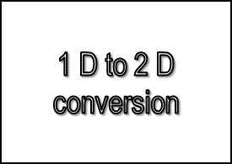
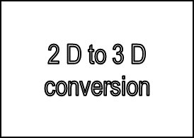
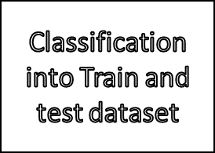
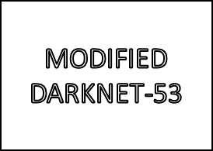
PROPOSED METHODODOLOGY
Ultrasonic signals are one Dimensional in nature
Extensive research is already carried out to identify the defects using One Dimensional transforms and One Dimensional classifiers
However the performance of the classifier has to be increased
Hence the proposed methodology aims at converting one Dimensional signal into two Dimensional images and hence the feasibility of a wide range of 2D deep learning networks can be studied
BLOCK DIAGRAM OF THE PROPOSED METHODOLOGY

Slide 12
RESEARCH DATABASE
A set of signals are acquired from Indira Gandhi Center for Atomic Research (IGCAR), Kalpakkam using AM70-4L Pulser Receiver. Three different flaws are introduced in Carbon and Stainless steel.
S.No. | Name of the defect | No. of signals
1 | Lack of Fusion | 65
2 | Lack of Penetration | 35
3 | Porosity | 58

Slide 13
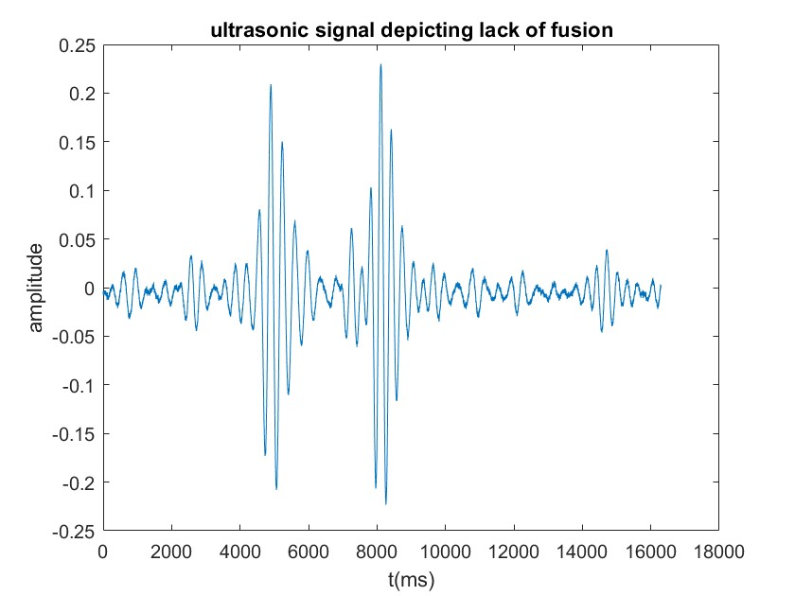
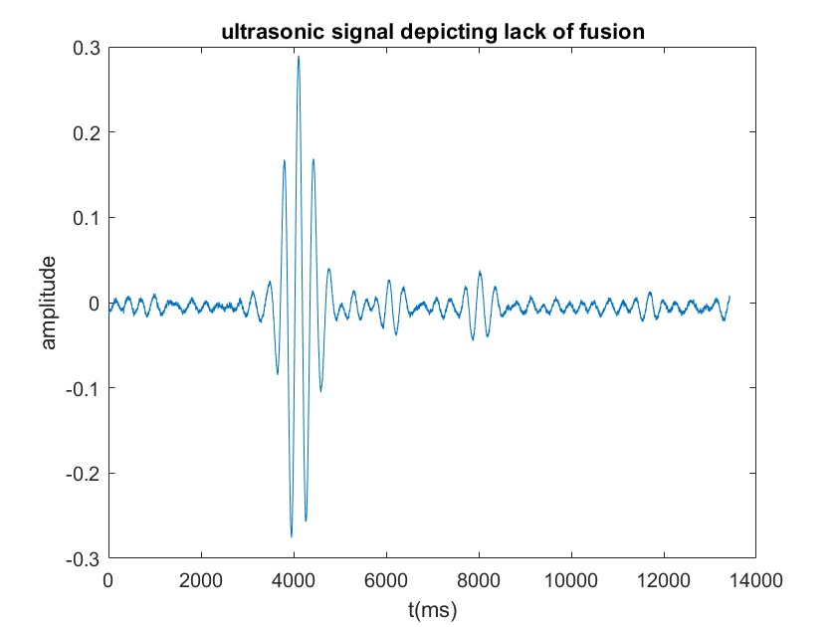
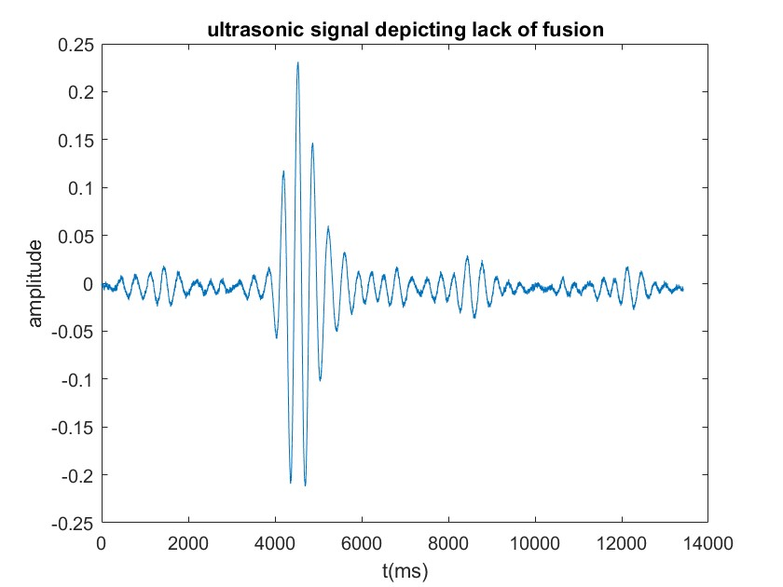
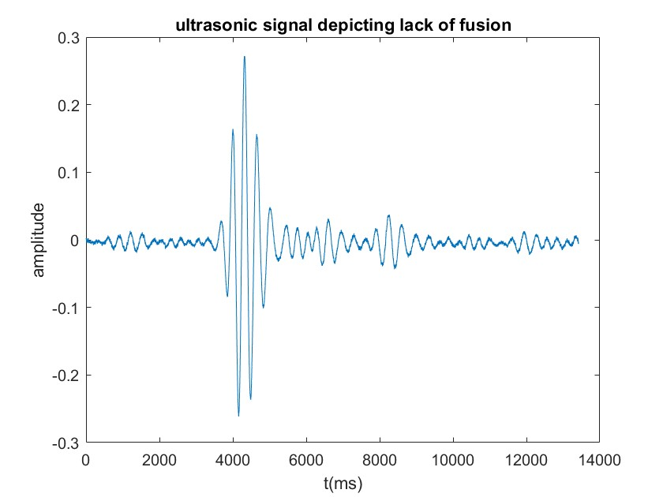
Lack of Fusion
Lack of fusion in welding refers to a welding defect where the molten metal fails to fuse adequately with the base material or previously deposited weld metal. It results in an incomplete bond between the two surfaces being joined, leading to a weakened and structurally compromised weld

Slide 14
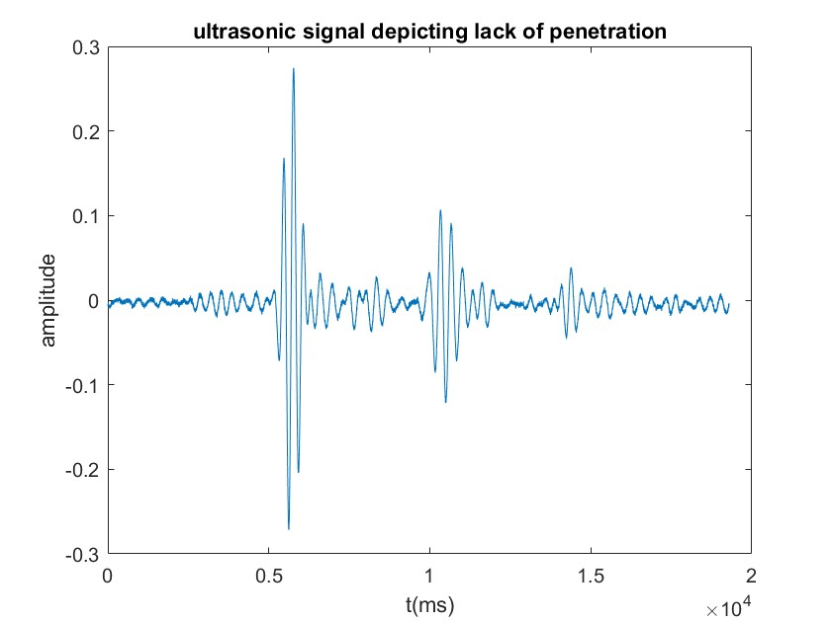
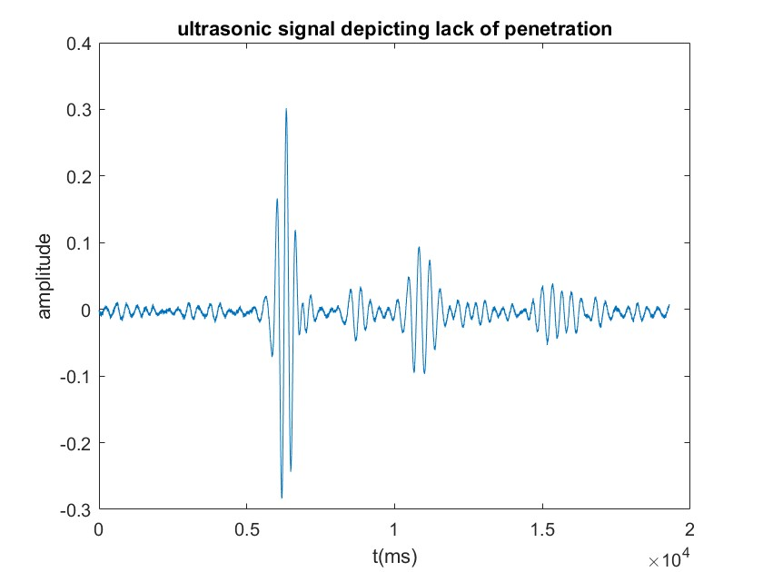
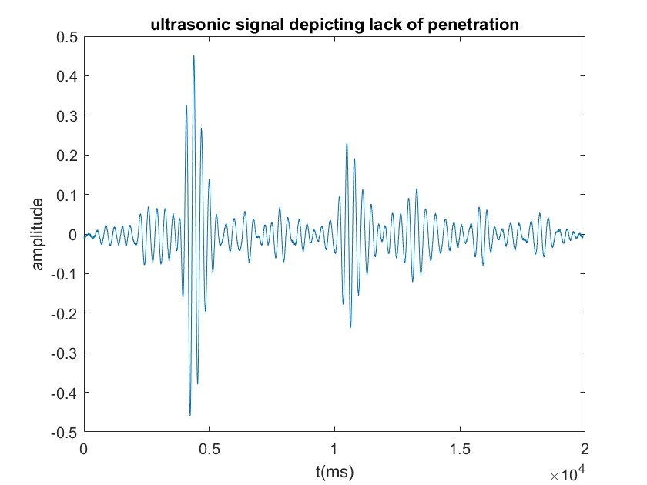
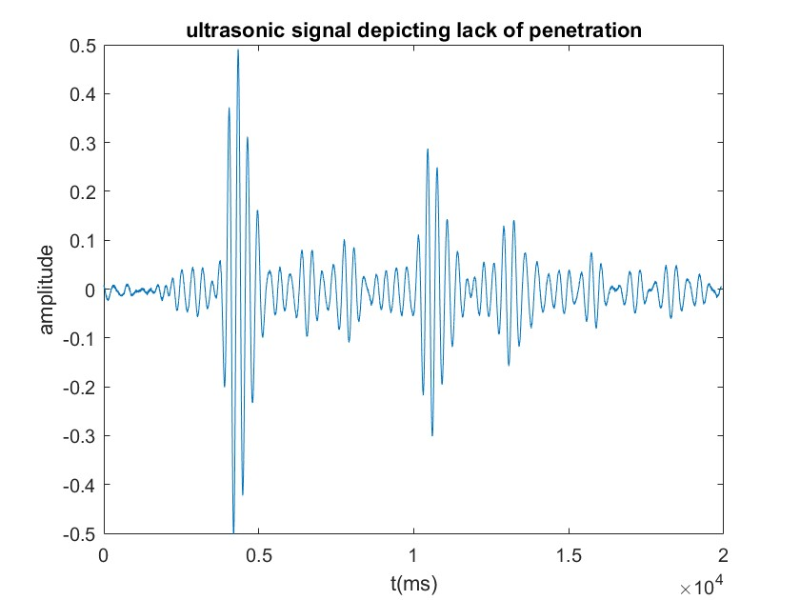
Lack of Penetration
Lack of penetration in welding refers to a welding defect characterized by insufficient depth of the weld metal into the base material. In other words, the weld fails to extend adequately into the joint, leading to a shallower weld than is required for the intended application. This lack of proper penetration can compromise the strength and integrity of the welded joint

Slide 15
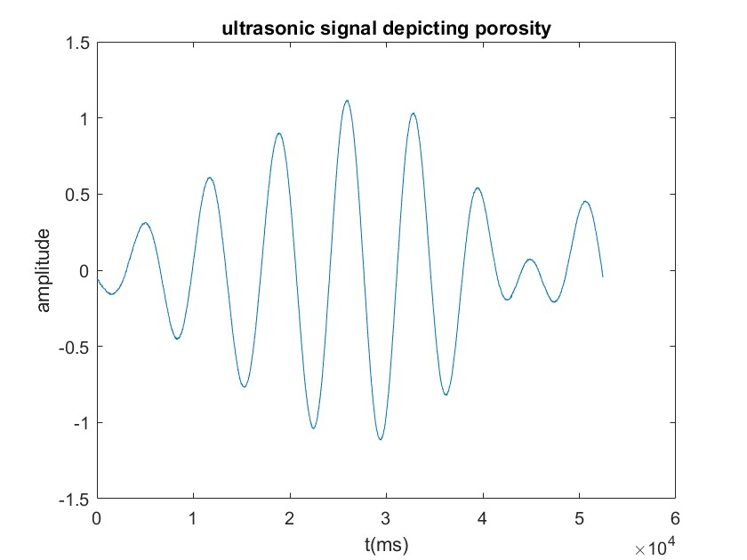
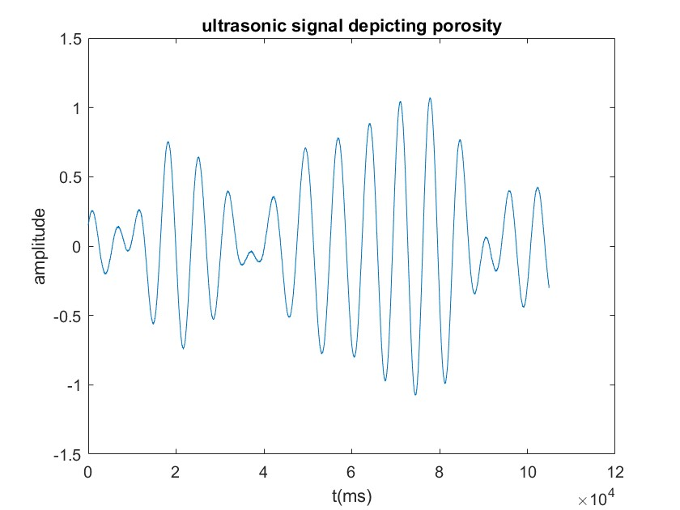
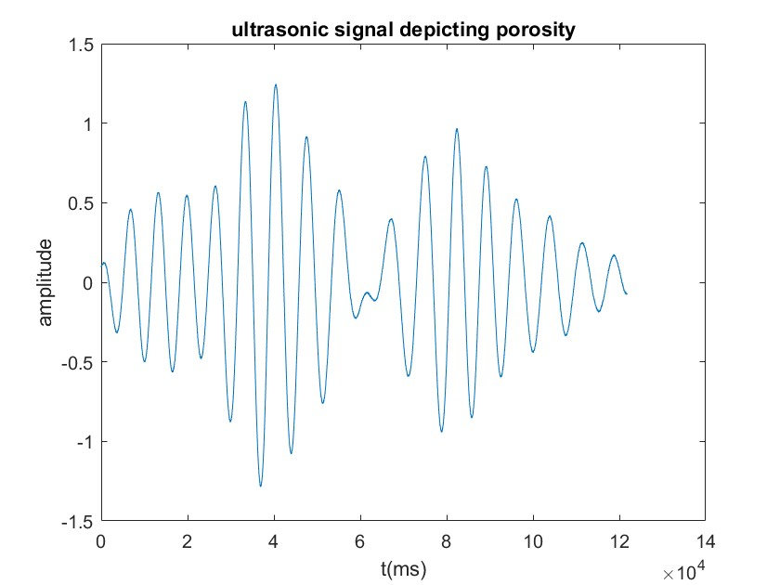
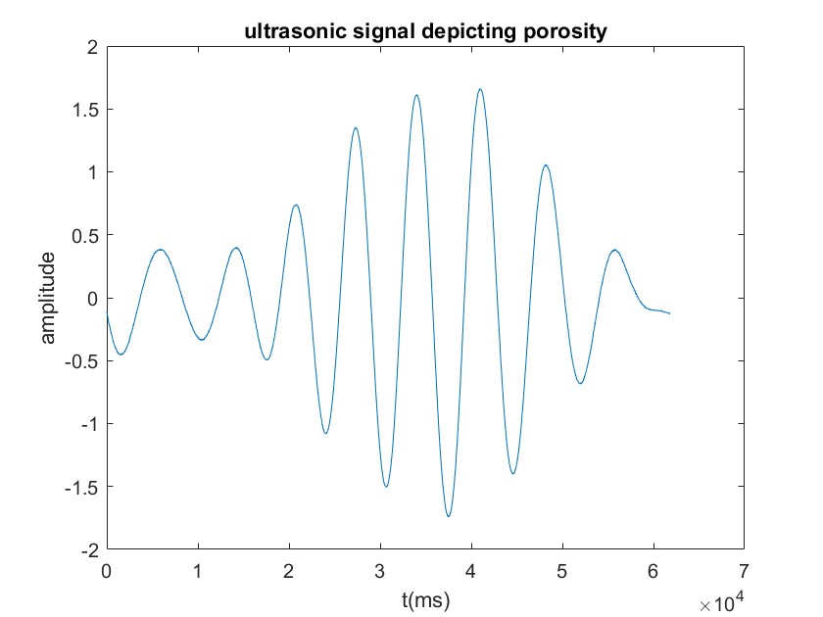
Porosity
Porosity in welding refers to the presence of gas pockets or voids within the weld metal. These gas pockets are typically trapped during the solidification process of the molten weld pool. Porosity can weaken the weld and compromise its structural integrity

Slide 16
ALEXNET – AN OVERVIEW
This was the first architecture that used GPU to boost the training performance
AlexNet consists of 5 convolution layers, 3 max-pooling layers, 2 Normalized layers, 2 fully connected layers and 1 SoftMax layer
Each convolution layer consists of a convolution filter and a non-linear activation function called “ReLU”
The pooling layers are used to perform the max-pooling function and the input size is fixed due to the presence of fully connected layers
The input size is mentioned at most of the places as 224x224x3 but due to some padding which happens it works out to be 227x227x3.Above all this AlexNet has over 60 million parameters

Slide 17
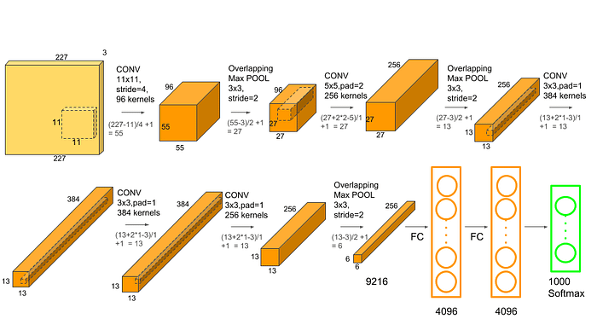
ALEXNET ARCHITECTURE
Courtesy: https://medium.com/analytics-vidhya/concept-of-alexnet-convolutional-neural-network-6e73b4f9ee30

Slide 18
DARKNET –AN OVERVIEW
Darknet53 is typically pre-trained on ImageNet for image classification, providing rich feature representations.
Darknet53 consists of 53 convolutional layers that has 3x3 convolutional filters for large feature extraction, stacking them in sequence and 1x1 filters for refinement of existing features.
Bypassing layers with direct connections combats vanishing gradients, improving information flow.
Darknet53 consists of 53 convolutional layers, along with additional layers such as input layer, max-pooling, batch normalization layer, activation layers, residual block, fully connected layer and output layer. These layers are organized into groups, with each group containing multiple convolutional layers followed by a max-pooling layer

Slide 19
MODIFIED DARKNET
Deep neural networks with a large number of layers are more prone to overfitting, especially when training data is limited and by reducing them we can mitigate it to some extent.
The modified darknet consists of 51 convolutional layers along with additional layers such as batch normalization layer, leakyReLu layers and other layers for mapping of the extracted features
Reducing the number of layers in conventional Darknet can lead to faster training and inference times, lower memory requirements, and simpler model interpretation
With fewer layers mean fewer parameters to store in memory, computational workload decreases, leading to faster training and inference

Slide 20
PARAMETERS
Training dataset
Test dataset
S.No. | Name of the defect | No. of Images
1 | Lack of Fusion | 45
2 | Lack of Penetration | 25
3 | Porosity | 40
S.No. | Name of the defect | No. of Images
1 | Lack of Fusion | 20
2 | Lack of Penetration | 10
3 | Porosity | 18
Training parameters
S.No. | Parameter | value
1 | Number of epochs | 18
2 | MSE | 0.00001
3 | Learning method | Gradient Descent Method

Slide 21
ALEXNET
Defects | Lack of Fusion | Lack of Penetration | Porosity | Sensitivity
Lack of Fusion | 8 | 0 | 12 | 40%
Lack of Penetration | 0 | 10 | 0 | 100%
Porosity | 0 | 3 | 15 | 83.33%
Overall Accuracy: 68.75%

Slide 22
DARKNET-53
Defects | Lack of Fusion | Lack of Penetration | Porosity | Sensitivity
Lack of Fusion | 17 | 2 | 1 | 85%
Lack of Penetration | 2 | 5 | 3 | 50%
Porosity | 1 | 0 | 17 | 94.44%
Overall Accuracy: 81.25%

Slide 23
MODIFIED DARKNET
Defects | Lack of Fusion | Lack of Penetration | Porosity | Sensitivity
Lack of Fusion | 15 | 2 | 3 | 75%
Lack of Penetration | 0 | 10 | 0 | 100%
Porosity | 1 | 0 | 17 | 94.44%
Overall Accuracy: 87.50%

Slide 24
CONCLUSION & FUTURE WORK
Ultrasonic signals depicting Lack of Fusion, Lack of penetration and porosity are collected
These one Dimensional signals are converted into Two Dimensional signals.Two dimensional signals are then converted to 3 Dimensional and are used for training and testing the network
Performance is measured in terms of sensitivity and accuracy
In this work, feasibility of Modified DARKNET for the classification of defects is studied and the accuracy has significantly improved
However the performance of other networks are yet to be studied for the classification of defects
We have stopped at the progression at the software level, leaving room for potential hardware implementation in next stages
Overall accuracy of ALEXNET is 62.50% and DARKNET is 81.25% and MODIFIED DRAKNET is 87.50%

Slide 25
REFERENCES
[1] W. Li, J. Qi and H. Sun, "TAF2-Net: Triple-Branch Attentive Feature Fusion Network for Ultrasonic Flaw Detection," in IEEE Transactions on Instrumentation and Measurement, vol. 71, pp. 1-12, 2022, Art no. 2503512, doi: 10.1109/TIM.2022.3150592.
[2] M. Liu, "Ultrasonic Inspection And Defect Identification of Thin - Walled Stainless Steel Welded Pipe Weld," 2022 9th International Forum on Electrical Engineering Automation (IFEEA), Zhuhai, China, 2022, pp. 995-998, doi: 10.1109/IFEEA57288.2022.10037864.
[3] A. Baradarani, A. Denisov and R. G. Maev, "Accurate Location of Key Features in Ultrasonic-based Spot Weld Inspection," 2022 IEEE International Ultrasonics Symposium (IUS), Venice, Italy, 2022, pp. 1-2, doi: 10.1109/IUS54386.2022.9958162.
[4] Sudheera, K., Nandhitha, N.M., Sai, V.B. et al. Deep Learning Techniques for Flaw Characterization in Weld Pieces from Ultrasonic Signals. Russ J Nondestruct Test 56, 820–830 (2020).

Slide 26
THANK YOU

